Slide 1
Context of the work
Since Filterland began operating in e-commerce, the business has grown significantly, leading to increased demand and the need to expand the Fulfilment Centres. These warehouses operate as demanding, high-tempo environments where some level of pressure is expected.
However, persistent operational friction can gradually erode morale, performance, and staff retention.
The organisation engaged the consulting group to evaluate employee feedback data, identify the friction points, the workforce segment most affected, and where an intervention would create the most leverage.
This document contains a summary of the findings, which are based on employee feedback data, stakeholder interviews, and HR operational data.

Slide 2
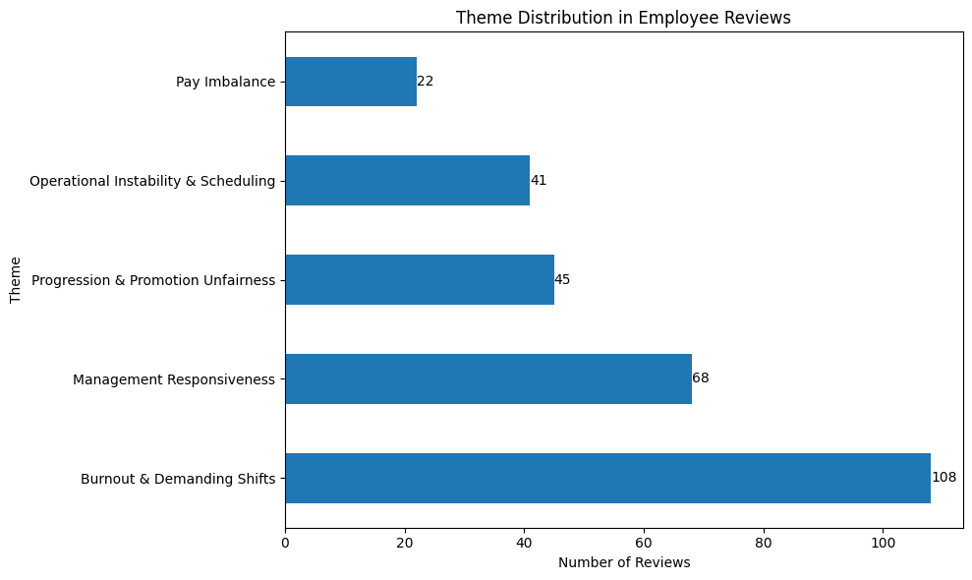
Operational friction is emerging across themes that directly affect workforce stability
36% of the employees referenced burnout in their feedback.
22% mentioned management responsiveness as a friction point.
Instability appears consistently, though lower in volume.

Slide 3
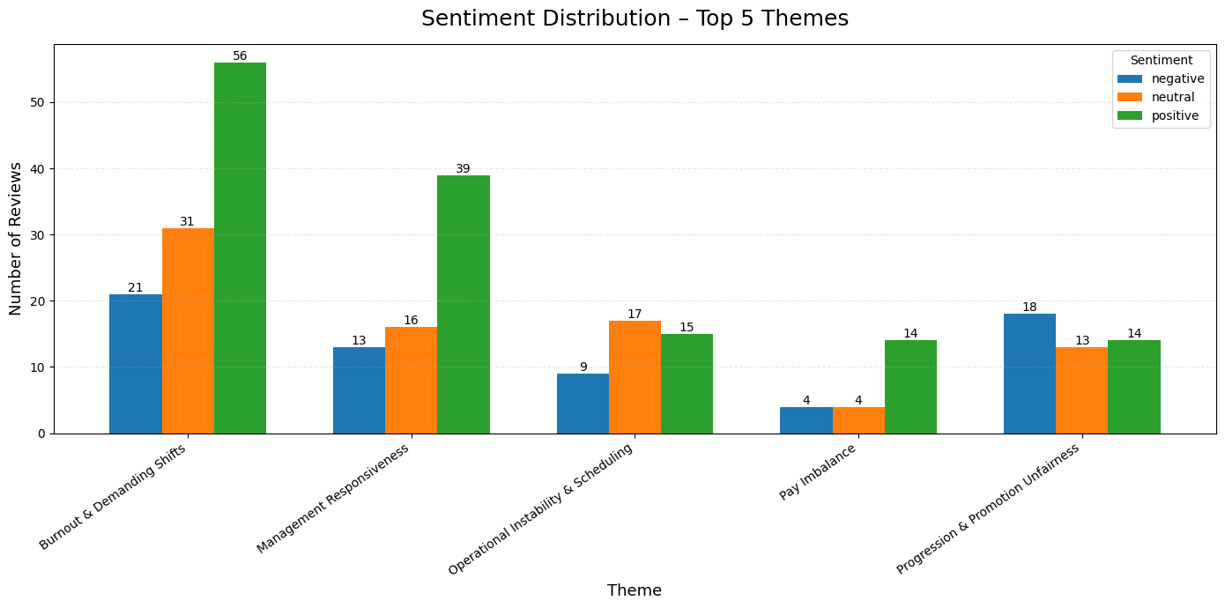
While workload is highly visible, patterns suggest instability is more destabilising
Promotion unfairness signals long-term engagement risk.
Operational instability signals near-term morale and productivity risk.
We are sequencing interventions accordingly.

Slide 4
Regular forklift operators represent the highest leverage intervention point
Regular Forklift Operators rank highest due to their operational criticality, elevated sentiment-weighted severity across instability and fairness themes, and substantial segment size
Segment | Impact (1–5) | Severity (1–5) | Size (1–5) | Priority Score | Rank
Regular Forklift Operators | 5 | 4 | 4 | 80 | 1
Regular Stowers | 4 | 4 | 4 | 64 | 2
Regular Warehouse Associates | 4 | 3 | 4 | 48 | 3
Part-Time Stowers | 3 | 3 | 3 | 27 | 4
Part-Time Forklift Operators | 3 | 3 | 3 | 27 | 4
Contract Stowers | 2 | 2 | 2 | 8 | 5
Contract Forklift Operators | 2 | 2 | 2 | 8 | 5
Contract Warehouse Associates | 2 | 2 | 2 | 8 | 5

Slide 5
Recommended intervention and pilot plan
Introduce a Fixed-Rota Stability Window & Transparency Log.
- Publish unit schedules 2 weeks in advance.
- Any rota change within 72 hours must be logged with reason, approver, and impacted operator.
Who will lead the intervention (People)
- The shift supervisor will explain the new process in team huddles, publish the schedule, and log changes.
Where and when will it be tested (Process)
- Pilot the intervention for 3 weeks with the team in the North -West.
How do we measure impact (Measurable)
- Track the percentage of rota changes made less than 72 hours before shift, and the number of logged reasons
The pilot intervention is low-cost because it uses an existing rota system that directly addresses instability, led by team supervisors, and can be measured through the tracking system.
Does this intervention tick all the boxes?
- Low-cost? Yes, because it uses an existing rota system.
- High-impact? Directly addresses instability.
- Team-led? Supervisors are responsible.
- Measurable? Rota change frequency log count.

